Slide 1
HOTEL MANAGEMENT SYSTEM
Group 7
Mannu Thomas
Manisha Mathew
Neha Ann Suresh
Nikitha A Paul

Slide 2
SPECIAL THANKS TO
Ms.Anne Dickson
Ms.Poorna B.R.

Slide 3
Problem Statement
The existing hotel database management system is based on manual working consisting of bill books. The need to check the reservation in the book is time consuming and manual errors are also possible.
This application aims in removing the above said problems and make it easier for the user to maintain an accurate record. Searching and displaying individual records will also be easier.

Slide 4
SOLUTION
We have created a hotel database management system where people can easily book rooms and admins can handle them effortlessly.

Slide 5
SOFTWARE USED
Graphical user interface
Tkinter
Database
Sqlite3
Language used
Python

Slide 6
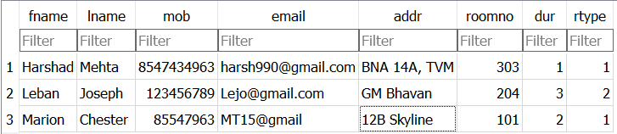
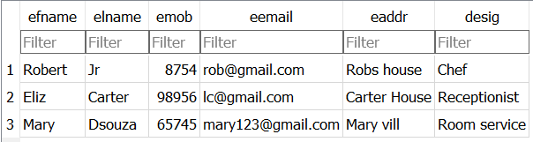
Tables created:
Guests table:
Employee table:

Slide 7
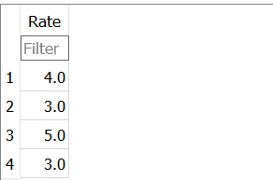
Rating table:

Slide 8
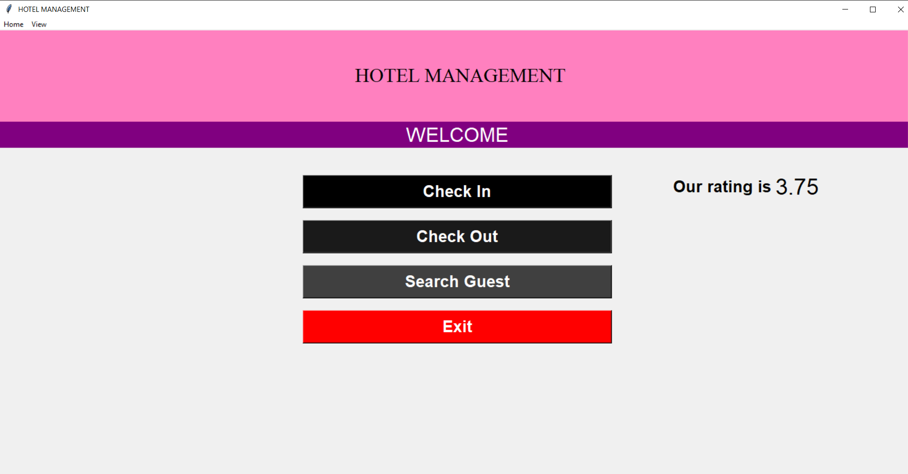
Interface created

Slide 9
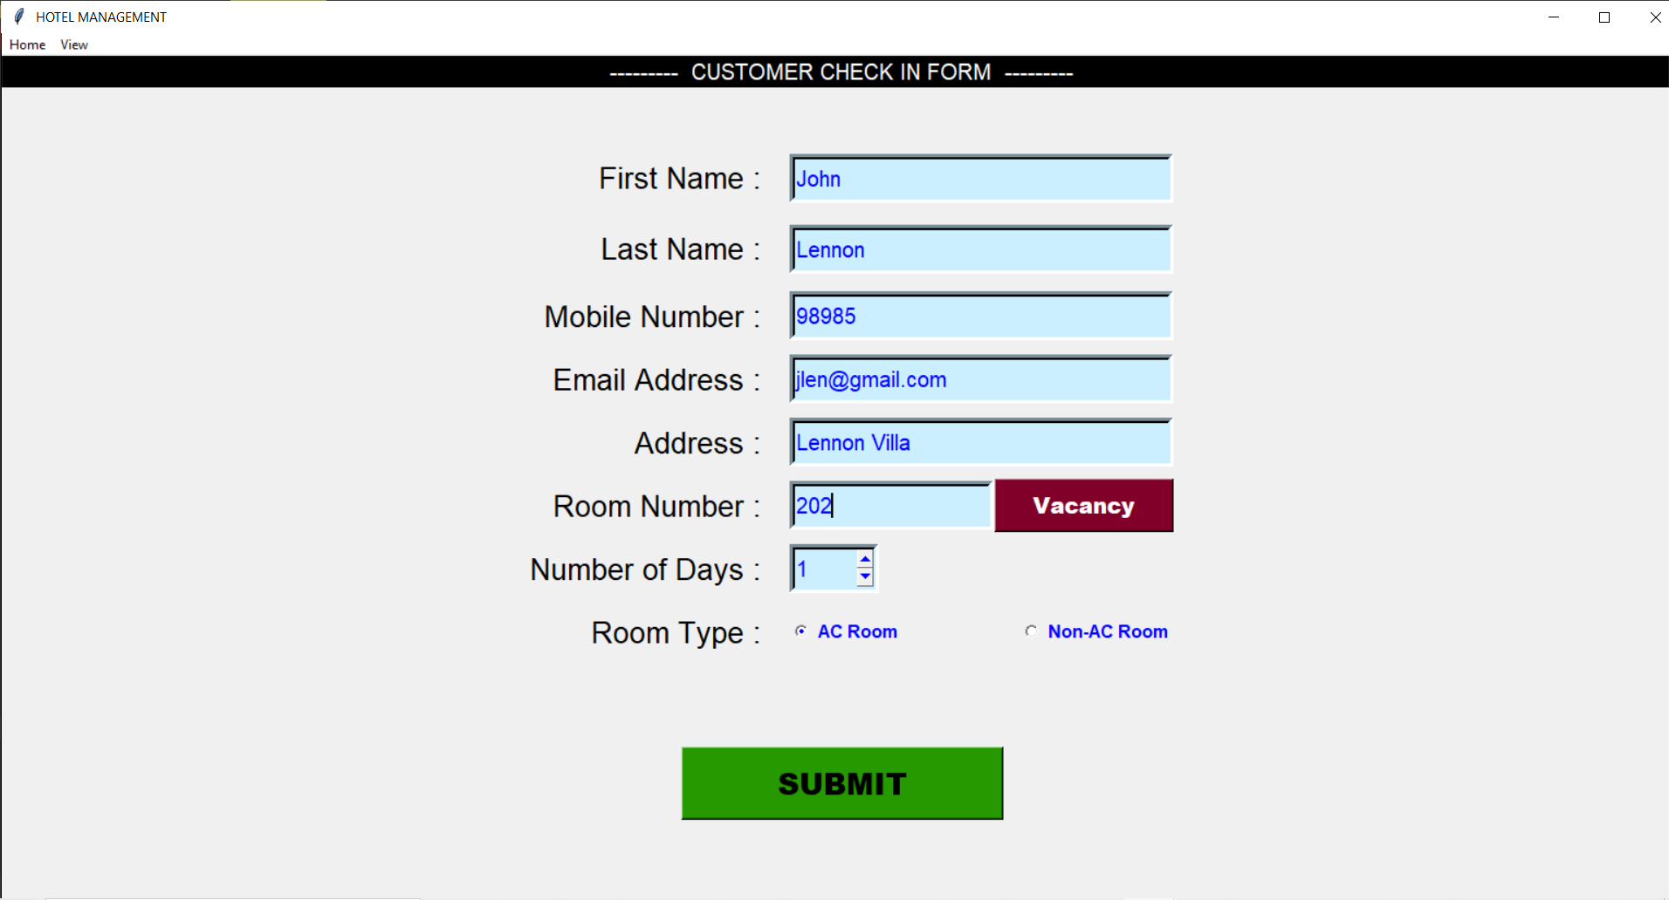
Check in form

Slide 10
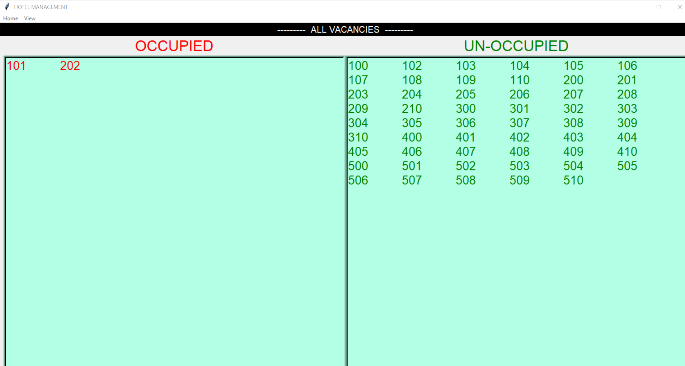
Vacancy

Slide 11
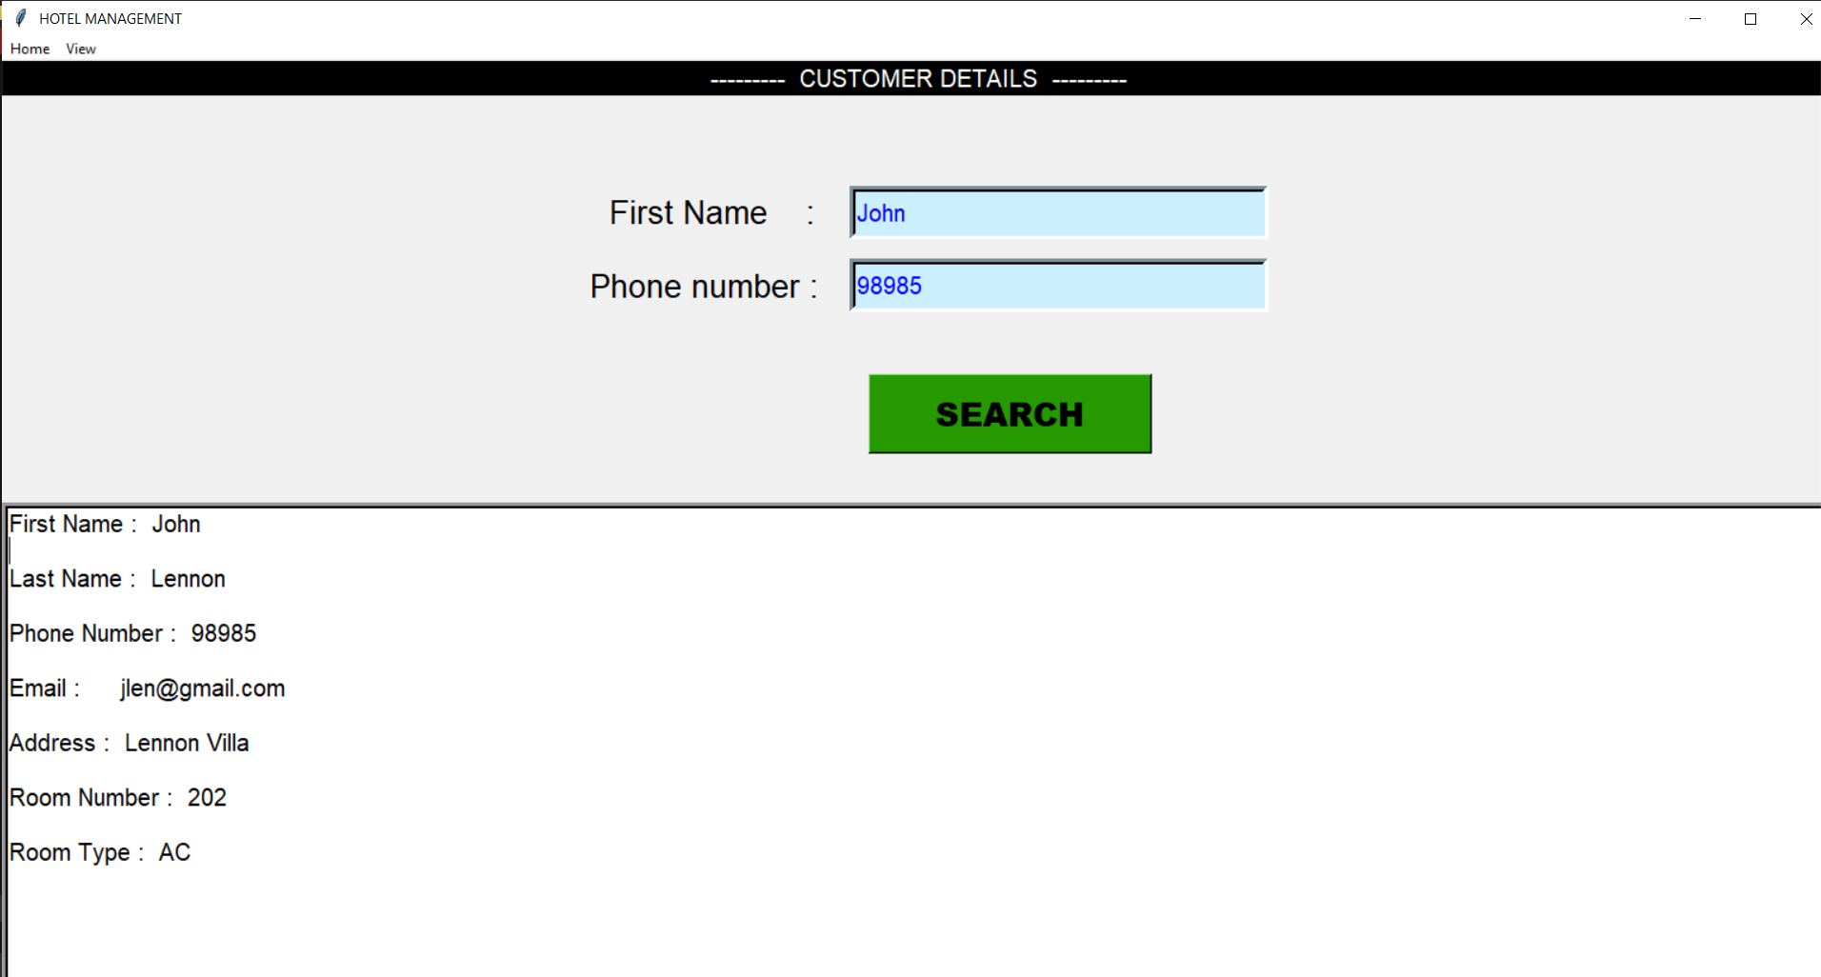
Customer Details

Slide 12
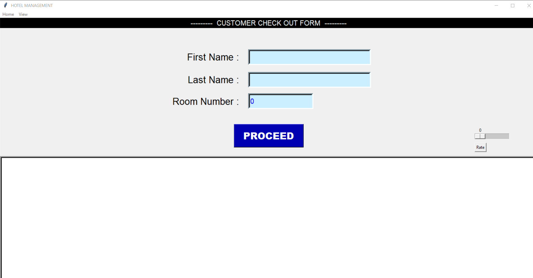
Check Out form page

Slide 13
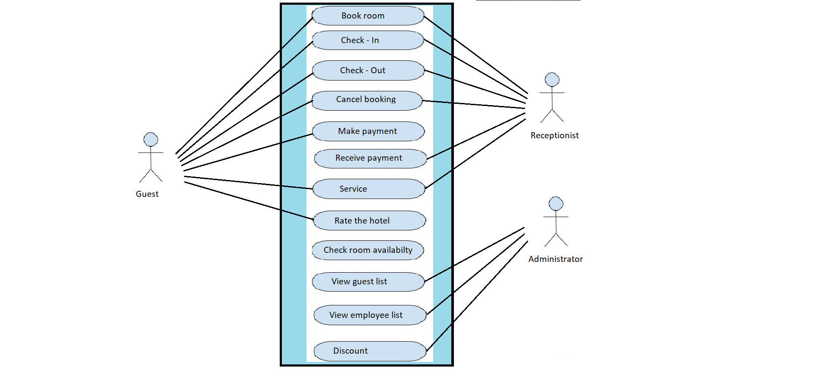
USE - CASE DIAGRAM

Slide 14
THANK YOU

